Slide 1
Bayasgalant is a small Swiss charity supporting children in need in the Mongolian capital Ulaanbaatar. The organization was founded in Nidau in 2003

Slide 2
The aim of Bayasgalant is to provide the children and their families with the necessities to live above the poverty line

Slide 3
In order to achieve this goal, Bayasgalant works with two projects:
the daycare centre with 75 children

Slide 4
and the
home care where
30 children and their families get support

Slide 5
At the daycare centre
they receive food, education, medical help and support with their school-work

Slide 6
The children also are taught basic needs such as hygiene, social behaviour, respect for others while still having time to play

Slide 7
The teachers are providing a friendly and supportive environment where both the children - and teachers - enjoy spending time together

Slide 8
Home care: The social workers visit the families at their home in order to help them with their urgent needs.

Slide 9
Some of them are battling with illnesses while others are unemployed and some have no home at all.

Slide 10
Bayasgalant also offers micro-credits if families want to start their own business.

Slide 11
The products they produce, are slippers and laptop covers from felt and purses folded out of milk cartons

Slide 12
Mongolian winters are long and cold, the temperature often drops to – 40C and only during three summer months there is no frost at night

Slide 13
Bayasgalant plans to build a house in 2012 where 100 children can be looked after.
The organization is not supported governmentally and donors are private people only.

Slide 14
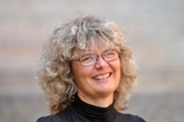
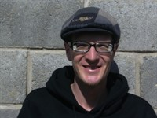
The organization is managed by a board with nine members. Managing directors are Christine Jäggi and Martina Züricher who share 80% employment.
In Mongolia there is a team of 10 employees, the people in charge are Zaya Okhinoo and Alexander Locher

Slide 15
Bayasgalant is politically and religiously neutral

Slide 16
If you would like to support Bayasgalant to give the children a better future, your donation is very much appreciated.
More information www.bayasgalant.org.
Thank you very much.

